Slide 1
Inter Company Connectivity Group (2) SHR1_ISS2_M1e

Slide 2

Team Members
1
2
3
4
Hady Mohamed Eldaly
Mazin Ayman Zahran
5
Ahmed Hassan Elsayed
(Absent)
Mohamed Salah Mohamed
Ahmed Wael Ali

Slide 3
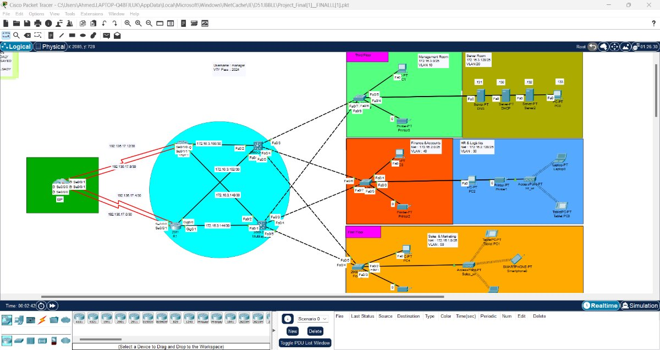

Slide 4
Project Idea
Build an Enterprise Network (Single Site)
Objective :“Inter Company Connectivity” is a project aimed at enhancing communication and coordination between different departments or levels within the company through an advanced networking infrastructure. The project focuses on connecting various floors or levels, facilitating seamless information and resource exchange, and promoting collaboration and productivity in the workplace.

Slide 5
Install internal network using Cisco Switches, Routers, Devices, and Servers.
Deliverables:
Design network using Cisco Packet Tracer:
4 Routers (2 OSPF – 2 ISP)
2 L3 SW
3 L2 SW
5 PC
3 Server
4 Print PT
2 Access point
2 laptop
2 tablet
Smart phone

Slide 6
Basic Settings for All Devices:
Hostname
Enable secret and VTY password (2024)
Welcome message
Encrypt all passwords
SSH Configuration on Routers and Layer 3 Switches (L3 SW)
Time & Date
Subnetting and ip addressing

Slide 7
VLANs and Port Assignments:
VLAN 10 (Management Room) Fa0/5, Fa0/6
VLAN 20 (Server Room) Fa0/1, Fa0/2, Fa0/3, Fa0/4
VLAN 30 (HR & Logistics) Fa0/1, Fa0/2, Fa0/3
VLAN 40 (Finance &Accounts)Fa0/4, Fa0/5
VLAN 50 (Sales & Marketing)Fa0/1, Fa0/2, Fa0/3
Assign VLANs to respective access ports.
Configure trunk ports between Layer 2 and Layer 3 switches.

Slide 8
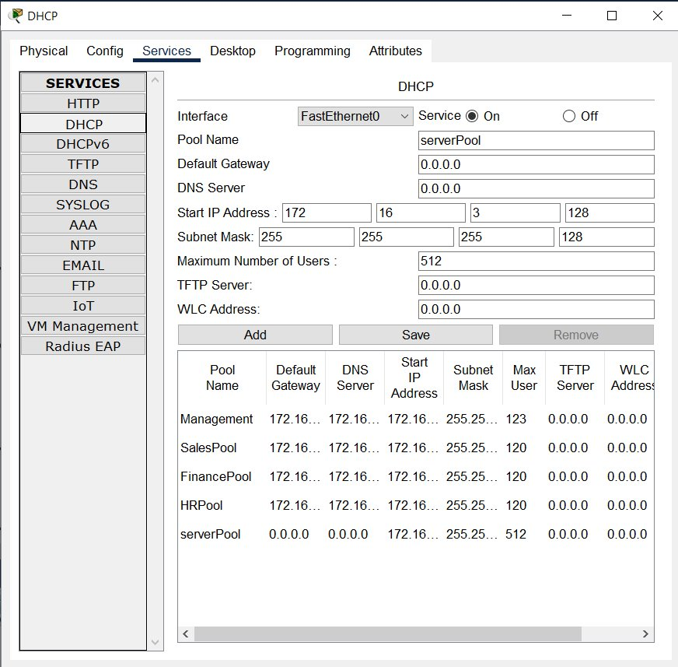
2.Set up Static IP addresses for the Management and Server Rooms (Third floor).
3.DHCP Server Configuration:
Configure the DHCP server to assign IP addresses to Management Room ,Server Room ,R & Logistics,Finance &Accounts and Sales & Marketing .

Slide 9
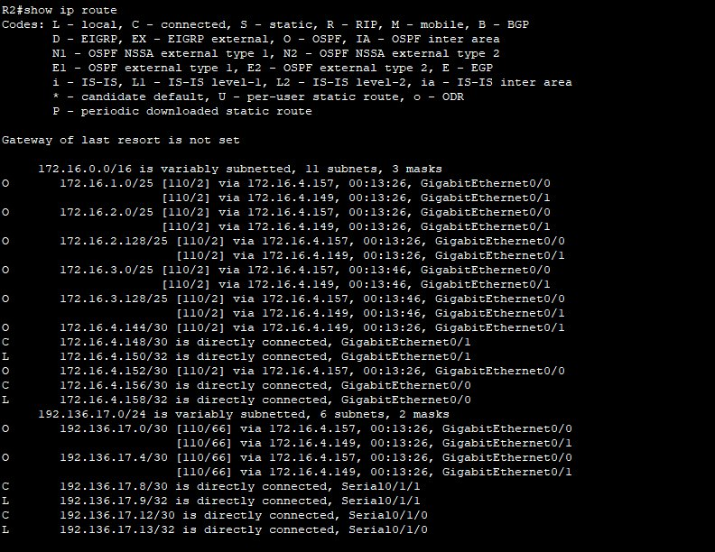
4.Inter-VLAN Routing:
Configure Inter-VLAN routing on the Layer 3 Switch.
Add IP Helper Addresses to forward DHCP requests between VLANs.
Config port security at accesses SW (portsecurity maximum ,violation restrict ,mac-add sticky )
Config acces port as port fast
Protect acces ports from unexpected BPDU

Slide 10
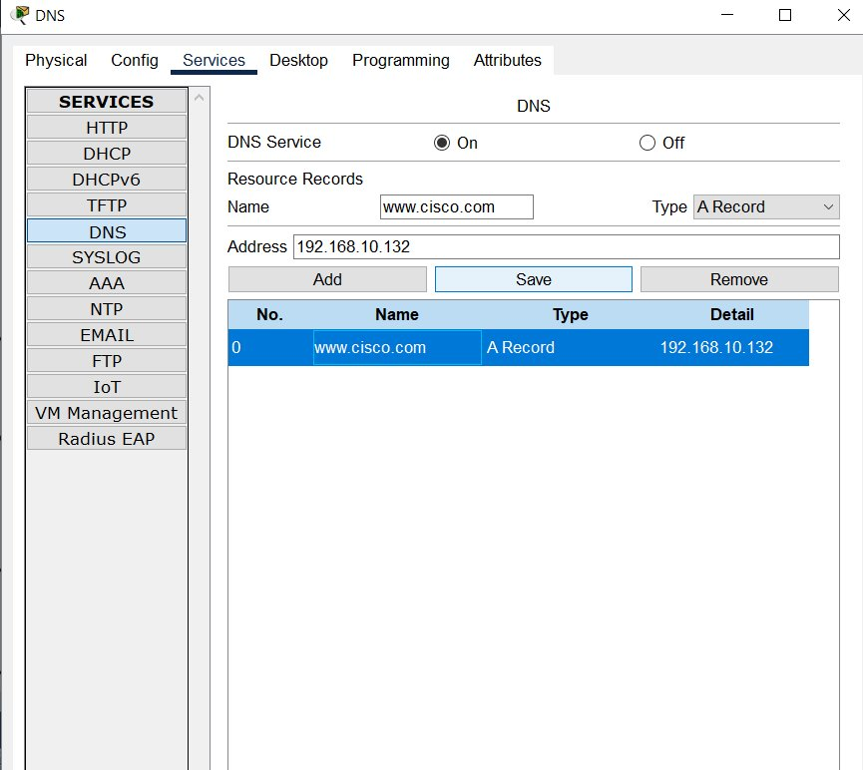
DNS Server Configuration :
The DNS server resolves domain names to IP addresses, simplifying network navigation for users.
This is critical for accessing services without needing to remember complex IP addresses, enhancing user experience and operational efficiency.

Slide 11
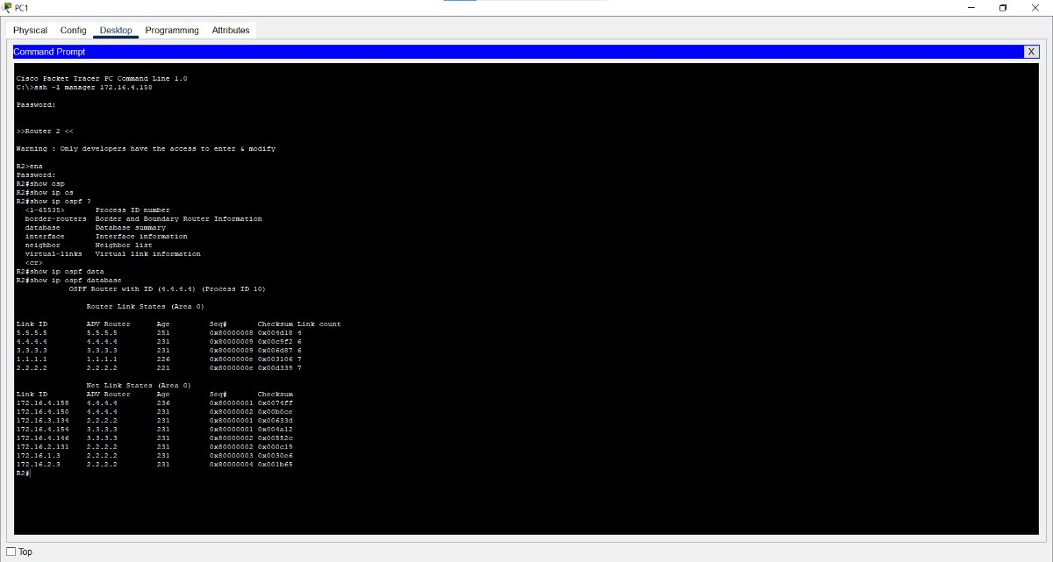
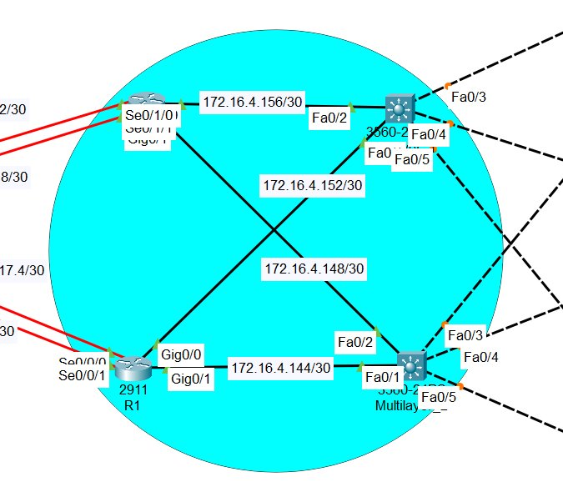
Routing Configuration: ​
1.OSPF (Open Shortest Path First) : is a dynamic routing protocol that efficiently manages data traffic across the network by determining the shortest path for data packets.​
​
​
This design improves routing efficiency and scalability by limiting the size of routing tables and minimizing the impact of network changes, ensuring fast and reliable data transfer between both locations.​

Slide 12
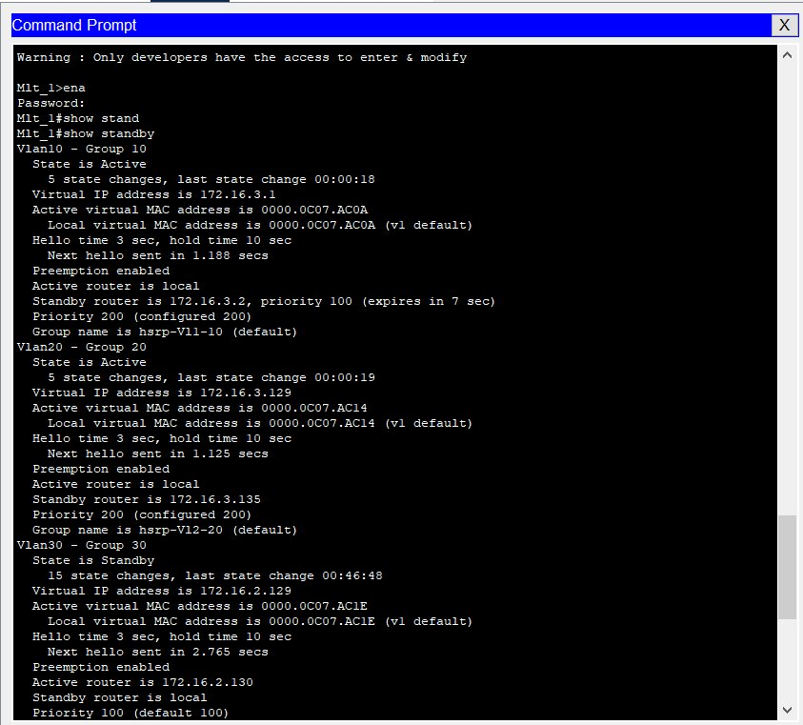
HSRP Protocole :
Configure HSRP protocol between multi layer switch and vlans.
Vlan 10 / Vlan 20
Multi layer Switch 1 (Active) ---> Priority =200
Multi layer Switch 2 (Standby)---> Priority (Default)
Vlan 30/40/50
Multi layer Switch 2 (Active) ---> Priority =200
Multi layer Switch 1 (Standby) ---> Priority (Default)
Preemption Enabled

Slide 13
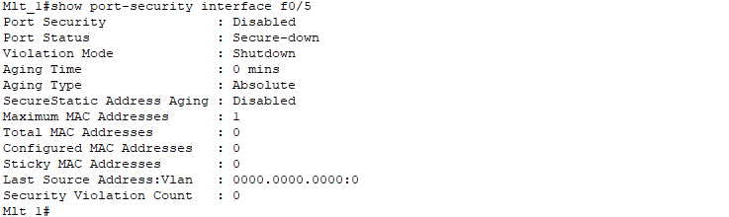
Switchport Security :
Config port security at accesses SW (portsecurity maximum ,violation restrict ,mac-add sticky )
Config acces port as port fast
Protect acces ports from unexpected PBDU

Slide 14
WIRLESS Configuration :
Configure wireless access points to provide network access to wireless clients.
Floor 1
Floor 2

Slide 15
Verifying and Testing Configurations
Verify and test all configurations, ensuring the network functions as expected.
Test connectivity between VLANs.
Validate OSPF routes and ensure redundancy.
Test wireless network performance.
Ensure management and server rooms have appropriate static Ips
Ensure HSRP is working correctly

Slide 16
AWESOME WORDS

